Slide 1
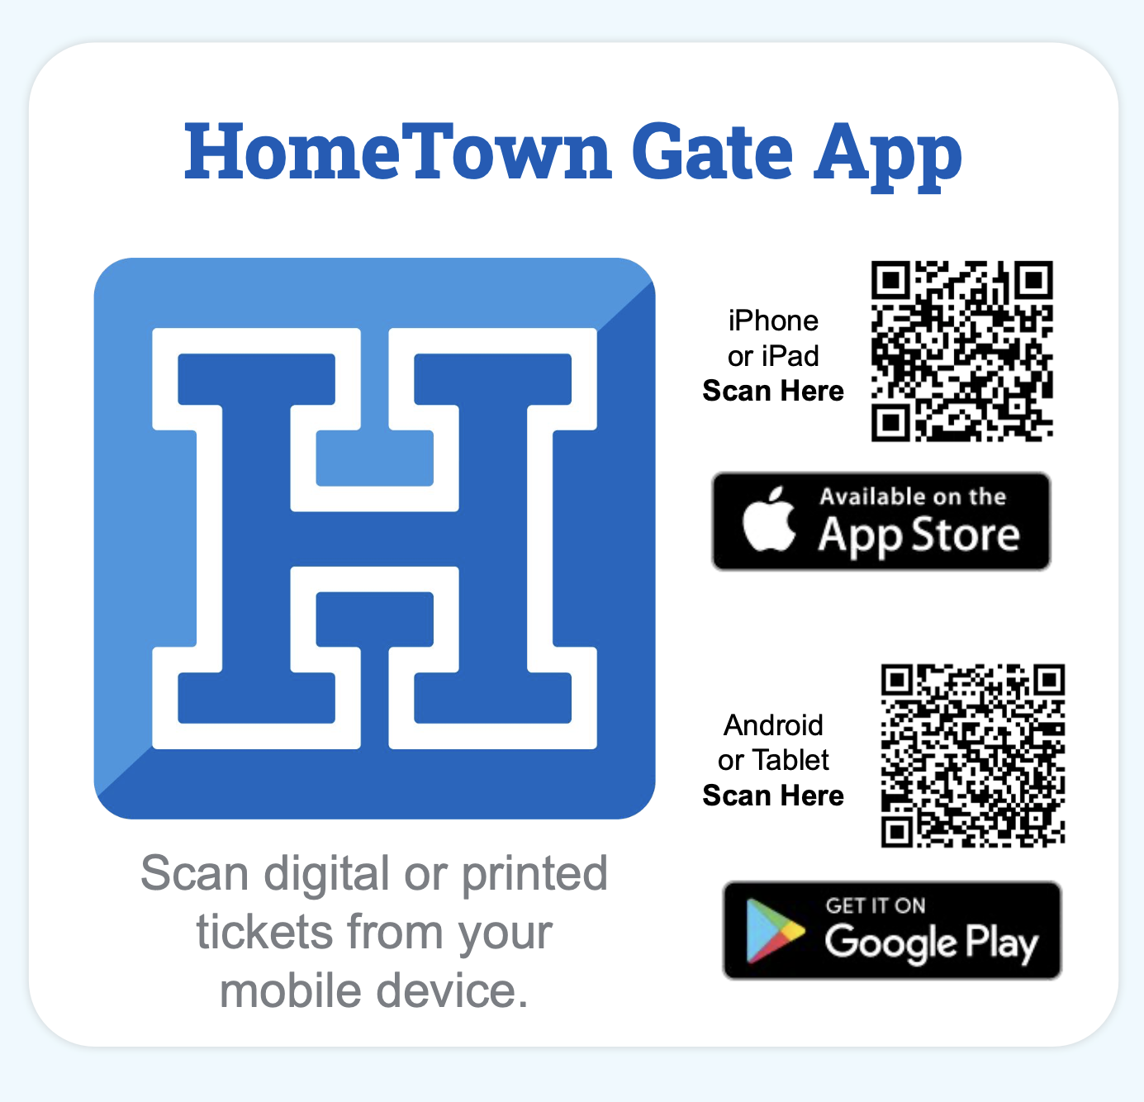

Slide 2
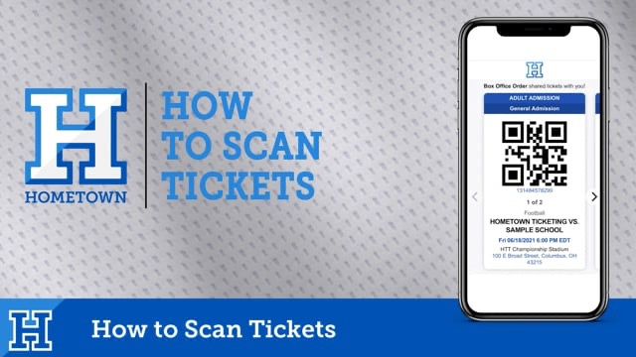
https://player.vimeo.com/video/447343758?color&autopause=0&loop=0&muted=0&title=0&portrait=0&byline=0#t= (Link to Video if it does not play)

Slide 3
Scan Your Fans with the HomeTown Gate App – iOS View
Easily scan digital or printed tickets from any iOS or Android device.
1
2
3
4
5
Secure Login
Select Event
Scan Ticket
Search Name
Adjust Settings

Slide 4
Scan Your Fans with the HomeTown Gate App – Android View
Easily scan digital or printed tickets from any iOS or Android device.
1
2
3
4
5
Secure Login
Select Event
Scan Ticket
Search Name
Adjust Settings

Slide 5
Scan Your Fans with the HomeTown Gate App
Easily scan digital or printed tickets from any iOS or Android device.
1
2
3
Valid
Duplicate
Not Found

Slide 6
Best Practices
Gate App Login Info:
  Client ID: piaad1 Username: d1scanner Password: D1scanner (Capital D)
Know the event you are scanning tickets for
Make sure the HomeTown Gate App is updated
Test connections prior to gates opening
Make sure all devices are fully charged
Consider backup power sources, outlets, portable charging devices

Slide 7


Contacts: chris.smith@hometownticketing.com
(440)-773-9539
HomeTown Customer Support # 1-866-488-4849
HomeTownTicketing.com | Follow us on social media:

